Slide 1

AI Infrastructure
Ioannis Papapanagiotou
AI Application Frameworks

Slide 2
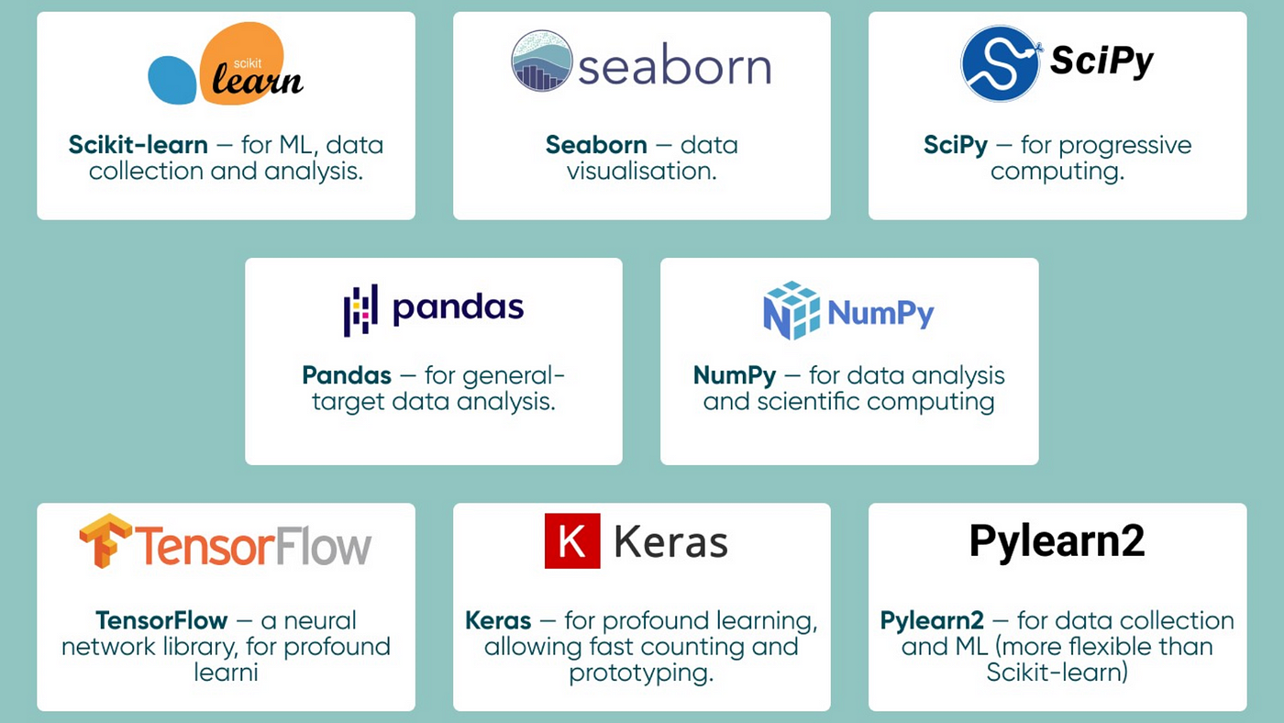
AI Frameworks and Libraries
AI software, particularly frameworks and libraries, are pivotal in developing and deploying AI models. These tools provide the environments and functionalities necessary for AI research and production.
AI Frameworks: The Backbone of AI Development
Frameworks like TensorFlow, PyTorch, and Keras offer comprehensive, flexible platforms for designing, training, and validating AI models.
They support various AI tasks, from simple linear regression to complex deep learning networks, accommodating the needs of both novice and expert AI practitioners.
AI Libraries: Specialized Tools for AI Tasks
Libraries such as NumPy, SciPy, and scikit-learn provide specific functionalities and algorithms that can be leveraged within larger AI projects.
These libraries are often used in conjunction with frameworks to perform tasks like data manipulation, statistical analysis, and machine learning.
Interplay between Frameworks and Libraries
The choice of framework or library depends on the specific requirements of the AI project, including the type of algorithm, computational efficiency, scalability, and ease of use.
Integration between different software components is crucial for building efficient and effective AI solutions.

Slide 3

Benefits of AI Frameworks
Apart from accelerating the project completion, they establish a common set of practices thus standardizing the process and ensuring consistency. They also ensure scalability.
AI frameworks are designed to handle the complexities of scaling AI models. They can accommodate varying workloads.
But perhaps the most important role is keeping up with advancements. Since AI is an ongoingly evolving field, these frameworks help development stay up-to-date with the latest developments. They can incorporate innovative approaches into their libraries.

Slide 4

Pytorch
PyTorch is a relatively new deep learning framework based on Torch. Developed by Facebook’s AI research group and open-sourced on GitHub in 2017, it’s used for natural language processing applications. PyTorch has a reputation for simplicity, ease of use, flexibility, efficient memory usage, and dynamic computational graphs. It also feels native, making coding more manageable and increasing processing speed.

Slide 5
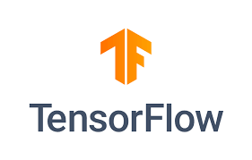
Tensorflow
Google Brain created the open-source TensorFlow framework, which is extensively employed in many artificial intelligence, machine learning, and deep learning projects. TensorFlow's extensive and adaptable ecosystem of tools, libraries, and community resources allows researchers to advance the state of machine learning. At the same time, developers can easily create and implement machine learning-powered apps.
A promising and fast-growing entry in the world of deep learning, TensorFlow offers a flexible, comprehensive ecosystem of community resources, libraries, and tools that facilitate building and deploying machine learning apps.

Slide 6
TensorFlow vs PyTorch: Ease of Use
PyTorch: Known for its Pythonic nature and simplicity,
PyTorch often appeals to beginners for its intuitive syntax and ease of understanding. It mirrors Python’s way of doing things, making it accessible to those familiar with it. Users often commend PyTorch for its straightforward approach to building and training neural networks, especially with its dynamic computation graph, which allows for changes on the fly. This makes experimenting and debugging relatively easier for beginners.
TensorFlow: Historically, TensorFlow was considered to have a steeper learning curve, primarily due to its static computation graph and more verbose syntax. However, this has changed significantly with the introduction of Keras as a high-level API within TensorFlow.
Keras provides an easier entry point for beginners with its user-friendly interface. TensorFlow’s recent versions have focused on improving user-friendliness, but it might still be perceived as more challenging initially than PyTorch.

Slide 7
TensorFlow vs PyTorch: Impact on Practical Model Building
PyTorch: The flexibility of PyTorch makes it ideal for research and prototyping, where the ability to tweak and adjust models rapidly is crucial. However, this flexibility can sometimes lead to less optimized models than TensorFlow, particularly for deployment in production environments.
TensorFlow: TensorFlow’s structured approach is beneficial for production environments where models must be scalable and highly optimized. However, this can sometimes slow down the experimentation process, making it less ideal for research purposes where rapid prototyping is required.

Slide 8
TensorFlow vs PyTorch: Speed and Efficiency
Benchmark Test Scenario: Imagine we’re training a basic Convolutional Neural Network (CNN) on a standard dataset like MNIST. The CNN will have a few convolutional, pooling, and fully connected layers. The performance metrics to focus on are training time and memory usage.
Results (Hypothetical):
In such a test, you might find that PyTorch and TensorFlow perform similarly in terms of training speed when running on a GPU. However, variations can occur based on the specific version of the framework and the hardware used. For instance, TensorFlow might slightly edge out in GPU utilization efficiency due to its static graph nature, which the underlying engine can more easily optimize.
Resource Usage: TensorFlow might show a bit more efficiency in memory usage compared to PyTorch, especially in larger and more complex models, thanks to its graph optimizations. PyTorch, with its dynamic graph, might consume more memory for the same task.
Notes:
https://yann.lecun.com/exdb/mnist/

Slide 9
TensoFlow vs PyTorch: Community and Support
PyTorch Community: PyTorch, developed by Meta AI, has seen a rapid increase in its community size, especially among researchers and academia. This surge is partly due to its user-friendly nature and flexibility, which appeal to research and development professionals. The community is known for actively participating in forums, and GitHub, and contributing to a growing repository of models and tools. PyTorch’s annual developer conferences, tutorials, and meetups further bolster its community engagement.
TensorFlow Community: TensorFlow, backed by Google, boasts a larger and more established community. It has many contributors ranging from individual developers to large corporations. TensorFlow’s community actively creates extensive resources, including detailed documentation, tutorials, and solutions to common issues. The framework’s long-standing presence and Google’s backing have cultivated a robust and diverse community.

Slide 10
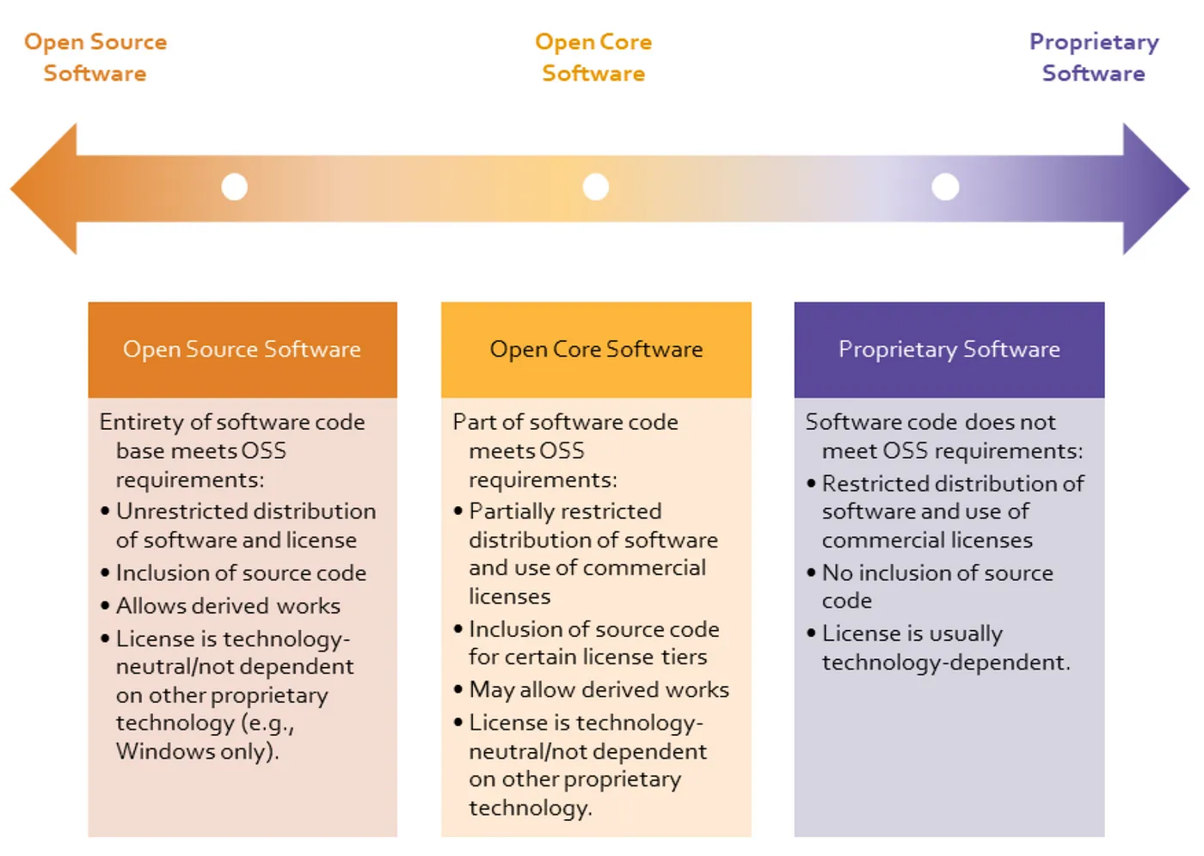
Open Source vs Commercial AI Frameworks

Slide 11
List of AI Frameworks
TensorFlow and PyTorch: Widely used for developing machine learning models. Comprehensive toolsets for creating and deploying ML models.
Scikit-Learn, Keras, and Caffe: Offer APIs for quick application development without starting from scratch. Suitable for various projects, from smaller prototypes to more complex deep learning tasks.
PyTorch: Known for its dynamic computational graph and favored by researchers.Excellent for prototyping and experimentation with a growing community.
Scikit-Learn: Python library for machine learning, open-source, and beginner-friendly.Well-suited for smaller projects and quick model prototyping.
TensorFlow: Open-source deep learning framework by Google, renowned for flexibility and scalability. Large and active community with extensive documentation and tutorials.
Keras: High-level neural networks API running on top of TensorFlow. User-friendly, ideal for quick prototyping, though may lack some advanced features.
LangChain: Gaining popularity for large language model (LLM) applications.Integration with various tools, including OpenAI and Hugging Face Transformers.
Hugging Face: Specializes in easy-to-use AI tools, known for the “Transformers” library. Provides tools for advanced machine learning tasks and web-friendly versions.
OpenNN: A tool for creating neural networks, fast and efficient, written in C++.Mainly used for research and decision-making based on data.
OpenAI: Offers a range of tools for various AI tasks, including GPT language models. Known for user-friendly AI capabilities, with some features requiring a premium subscription.
PyBrain: Open-source ML library for Python, lightweight and easy to use. Suitable for experimentation, education, and rapid prototyping.
IBM Watson: Suite of AI and machine learning services by IBM. Offers tools for building and deploying AI-powered applications, with expertise-backed robust capabilities.
Microsoft Cognitive Toolkit (CNTK): Free and open-source deep learning AI framework by Microsoft. Known for efficiency, especially on multi-GPU systems, suitable for research and production.
DL4J (Deeplearning4j): Open-source deep learning framework for Java and Scala developers. Designed for enterprise-level applications with support for distributed computing.

Slide 12
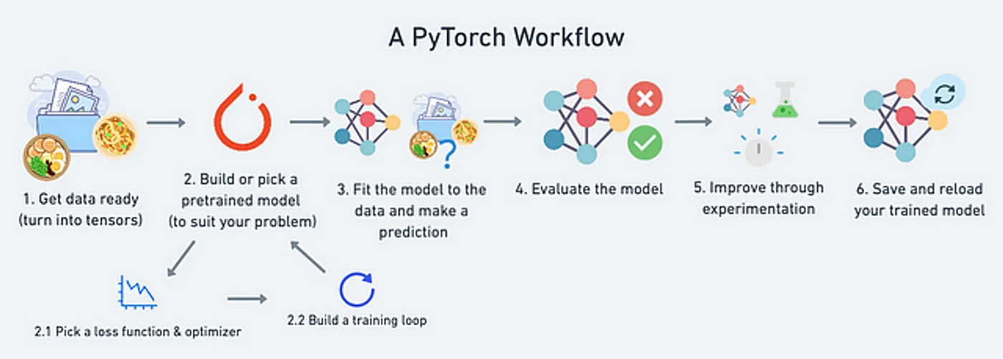
Challenges to Implementing AI
As you evaluate how to implement AI initiatives, it’s important to remember that much of the data driving AI is actually siloed in legacy infrastructure and is not necessarily in the right format nor is it easily accessible.
What’s more, there’s a massive amount of unstructured data to be processed!
And in many cases, that data has grown beyond a company’s infrastructure.
Dealing with much larger data sets requires more difficult computation and algorithms; the truth is, most of your time could be spent cleaning data, de-identifying it, and getting it to a point where it can be used to gather insights.

Slide 13
References
https://opencv.org/blog/pytorch-vs-tensorflow/

